Slide 1
Analyzing Amazon Sales data K.R.POORNIMA

Slide 2
Problem Statement
Sales management has gained importance to meet increasing competition and the need for improved methods of distribution to reduce cost and to increase profits. Sales management today is the most important function in a commercial and business enterprise.
KPIs: ETL: Extract-Transform-Load
TO DO:
Extract-Transform-Load some Amazon dataset
Sales-trend -> month-wise, year-wise, yearly_month-wise
Find key metrics and factors
Show the meaningful relationships between attributes.

Slide 3
Architecture description
Raw Data Collection : The Dataset Provided by Unified mentor Platform.
Data Pre-Processing : Before building any model, it is crucial to perform data pre-processing to feed the correct data to the model to learn and predict. Model performance depends on the quality of data fed to the model to train.
Data Cleaning : is the process of fixing or removing incorrect, corrupted, incorrectly formatted, duplicate, or incomplete data within a dataset.
Exploratory Data Analysis (EDA) : refers to analyze and investigate data sets and summarize their main characteristics, often employing data visualization methods.
Reporting : is the process of collecting and formatting raw data and translating it into a digestible format to assess the ongoing performance of your organization.
.

Slide 4
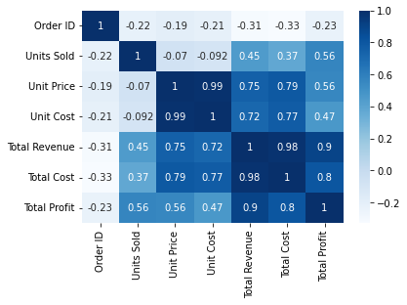
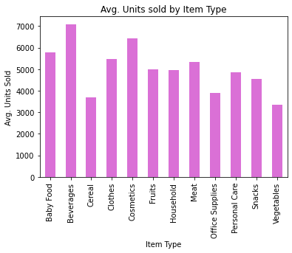
Analysis using Python
As we can see in the above heatmap Unit Price and Unit Cost are Highly corelated. And Unit Price moderately related to Total Revenue and Total Cost but less related to Total Profit. lastly their is No relation between Order ID and rest other features.

Slide 5
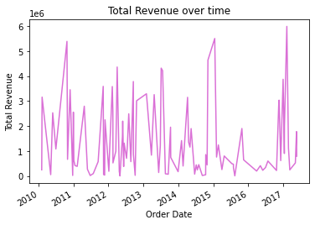
TOTAL REVENUE OVER TIME
Total Revenue over time from 2010 to 2017 is 137348768.31

Slide 6
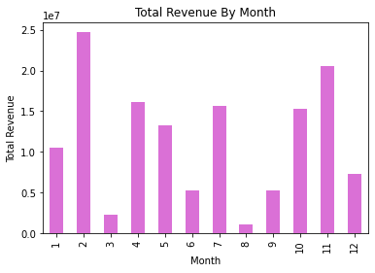
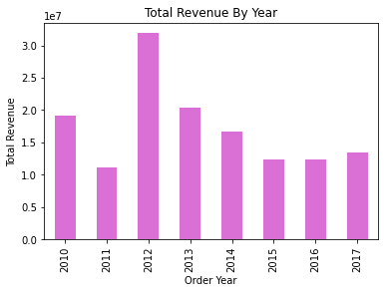
Month-wise Sales
Year-wise Sales

Slide 7
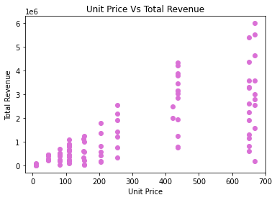
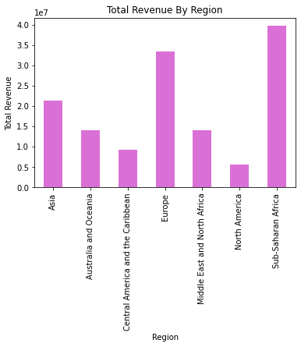
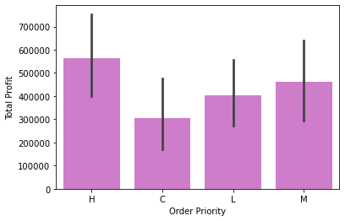
Unit price vs Total Revenue
Revenue by region

Slide 8
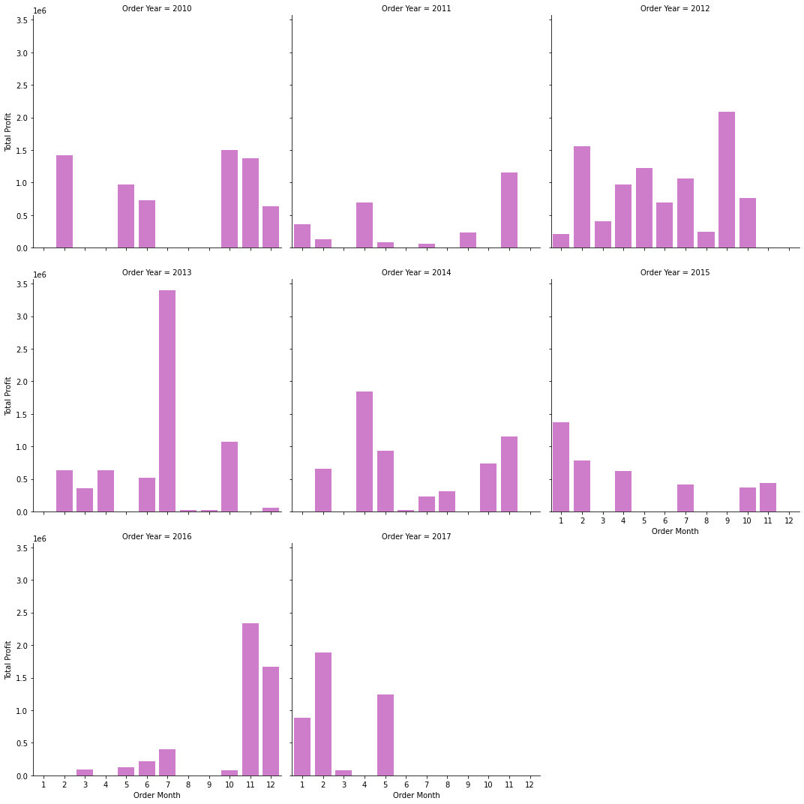
Yearly-Month wise

